Slide 1







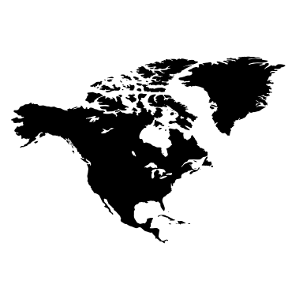
Homework 3
Stacy Montgomery, YaNing Wang , Andres Kim

Slide 2
Table of Contents
Workflow 3 - 7
Example final output 8 – 10
ReadME and GitHub 11

Slide 3
Workflow
Our code uses functions from TileSystem (re-written into our Python script)
The user inputs:
python3 script.py [lat1] [lon1] [lat2] [lon2] [optional: tilediff]
The script converts user input bounds into pixel coordinates using the TileSystem functions, and the optional tile difference allows for the user to increase resolution if the output is not to satisfaction.
The script continues to proceed to main user defined function, find_aerial_image()
The output is a figure with maximum resolution given user-defined bounds
User input:
36.158937,-121.672703,36.157742, -121.671458, 1
latlong_to_pixelXY()
X_pixel1, Y_pixel1,
X_pixel2, Y_pixel2

Slide 4
Workflow
Start find_aerial_image(), given XY converted pixels
Search from large to small tile levels for intersection
Generate quad key for tiles
and retrieve images
Stitch image
Tile difference = 1
Crop image
Given the bounding box (in blue), the algorithm find_aerial_image() searches through each level of tiles until each coordinate is located within 4 unique tiles. The number of tiles within the stitching algorithm can be set, with the default at 5 (shown here 1 difference). These tiles are then stitched together and cropped to the original lat-lon bounding box.

Slide 5
Workflow
Start find_aerial_image(), given XY converted pixels
Search from large to small tile levels for intersection
Generate quad key for tiles
and retrieve images
…
Stitch images
Tile difference =5
Crop image
When the bounds exceed a 1 tile difference, our algorithm stitches together all intermediate tiles. As previously noted, the default tile stitch is at 5 tile difference, which is shown here. We choose to allow for user input to increase or decrease resolution, as our algorithm finds the optimum resolution given the bounds.

Slide 6
Workflow
Start find_aerial_image(), given XY converted pixels
Search from large to small tile levels for intersection
Generate quad key for tiles
and retrieve images
Error 1
If the image is missing, then we back out to lower level
Crop image
When images are missing, our algorithm uses the lower resolution image instead of stitching the missing image. The code notifies the user of the missing image.

Slide 7
Workflow
Start find_aerial_image(), given XY converted pixels
Search from large to small tile levels for intersection
Generate quad key for tiles
and retrieve images
Stitch images
Tile difference = 1
Error 2
When bounding box is too wide, the resolution will be very low
Crop image
If someone inputs an extreme values lat,lon pair, (i.e.: -180,180 lon pair or -90,90 lat pair) the resolution will be very low and the height and width resolution will be dissimilar. This can be fixed by re-running the code and inputting a larger [tilediff] when running the code.

Slide 8
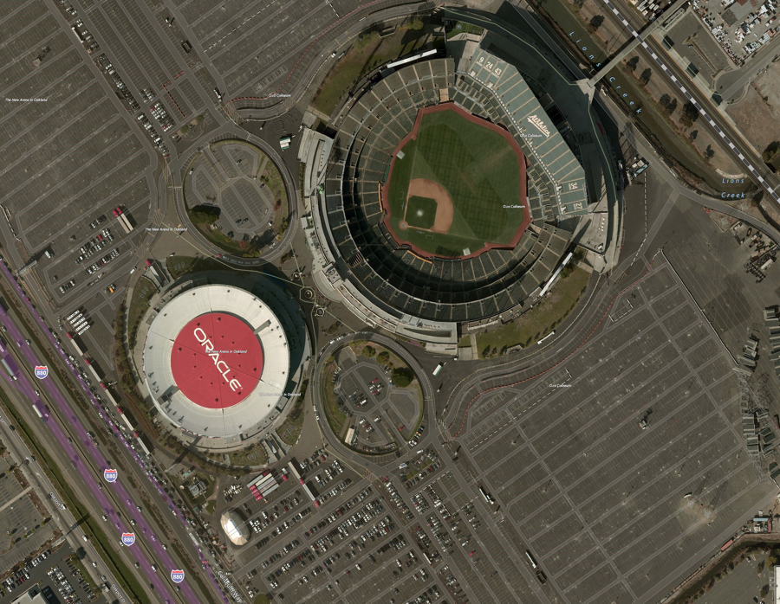
Example output
User input:
37.753051 -122.205149
37.74836 -122.197253
Tile level 19 | Scale 1 : 1,128.50 | Number of Tiles: 25

Slide 9
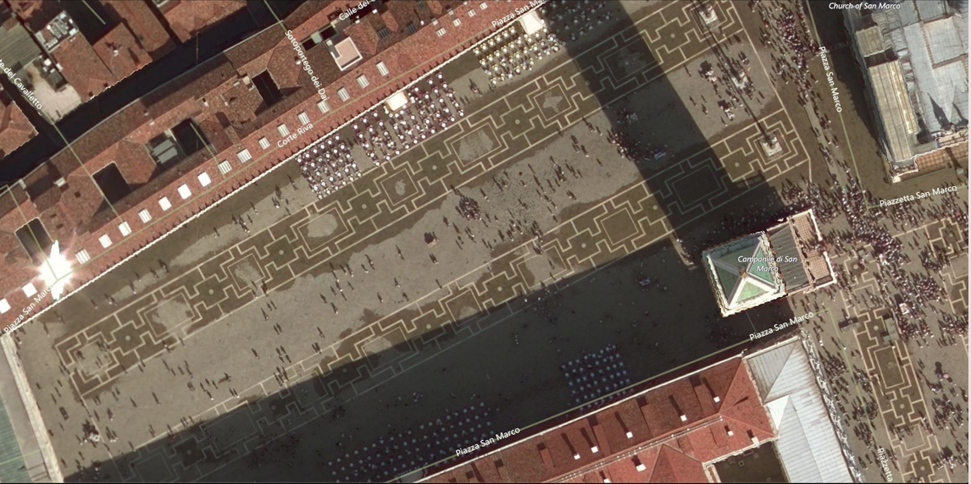
Example output
User input:
45.434522 12.337127
45.433657 12.339620 2
Tile level 20 | Scale 1 : 564.25 | Number of Tiles: 4

Slide 10
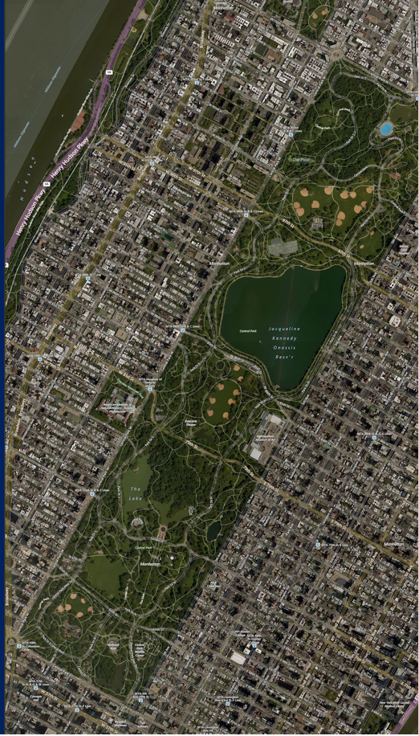
Example output
User input:
40.803605 -73.982370
40.762912 -73.952167
Tile level 16 | Scale 1 : 9,028.00 | Number of Tiles: 25

Slide 11
Further Work
If a user inputs a low resolution tile difference, and the image could be higher resolution, our code could notify the user of a higher resolution image availability. Currently, our code only notifies the user if the high-resolution tiles are missing, and returns the lower resolution image.

Slide 12
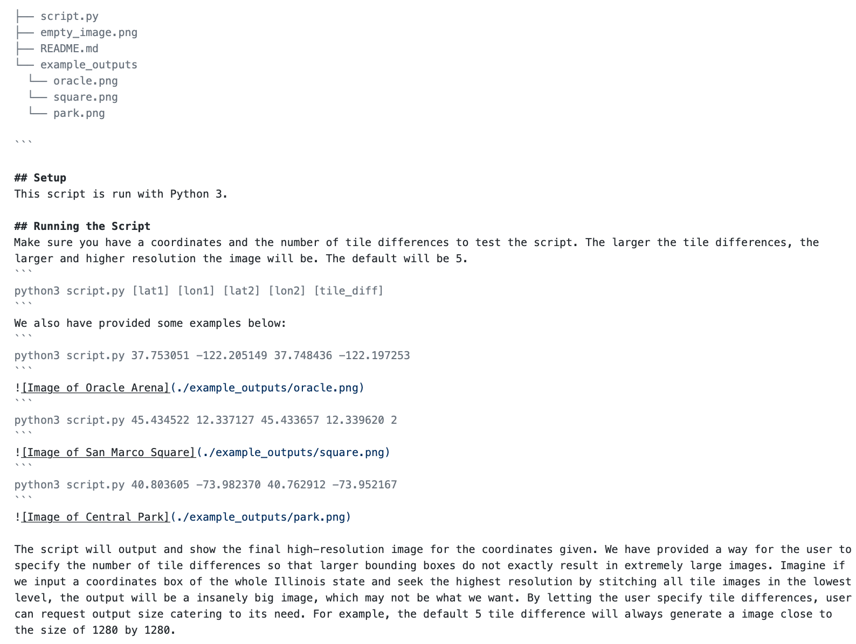
README & GitHub Repository
Github available here: https://github.com/afkim14/EECS395-HW3

